Slide 1

Crowdsourcing: a validated methodology for performing image quality assessments online
Philip Corriveau, Hanan Alnizami, Patrick E. McKnight, Jake Quartuccio, David Nicholas, Michele Saad

Slide 2
Agenda
Lab studies vs. crowdsourcing
Crowdsourcing Sampling
Crowdsourcing Compensation
Handling human subjects
Experimental design
    Study stimuli
      Validity checks
      Overlapping images
    Study design
    Data Analysis

Slide 3

Lab studies vs. crowdsourcing
Laboratory studies = Stringent procedures in controlled environments
Notes:
In the past, a number of standardized laboratory studies were conducted simultaneously to evaluate image and video quality, employed via stringent procedures (such as screening for visual acuity and color deficiencies) and in controlled environments (such as the tuning of ambient lighting, noise, chair comfort, viewing distances…etc). While these methods were proven to collect reliable and valid data, these procedures are expensive and lengthy for both the experimenter and the participant.

Slide 4



Lab studies vs. crowdsourcing
Crowdsourcing studies = Flexibility in experimental design for IQA
Notes:
Previous literature showed that controlled laboratory conditions are not needed to obtain reproducible subjective ratings; experimenters may capture equivalent data from more flexible experimental designs using online samples.
Crowdsourcing experiments provide experimenters access to difficult to recruit participants in a wider array of settings (e.g., image displays, ambient lighting, and participant motivation to name a few). These varied settings allow researchers to test image quality ratings across varying observed conditions and to determine the conditions that may most affect ratings outside the laboratory setting. All these benefits may come at a substantial costs if the crowdsourcing studies fail to abide by some key principles known to affect the results.

Slide 5





Crowdsourcing Sampling
Screening participants before a test
Screening participants when signing up for a test
1.
2.
Notes:
Crowdsourcing environments contain a massive pool of participant workers who are willing to partake in tasks submitted by requesters for a compensation
Screening before a test: crowdsourcing platforms allow requesters the ability to screen for certain worker demographics and usage characteristics by submitting study eligibility criteria to the platform (i.e. age, gender, geo locations…etc.).
Screening when signing up or a test:
Requesters can begin the test with questions that pertain to exclusion criteria. For example, if interested in recruiting participants who aren’t color blind, a requester could ask participants if they are color blind, then decide upon their answer whether they should participate in the test. In a situation where participants are not eligible but have answered the eligibility questions, requesters must inform participants that they have not met the eligibility criteria and must compensate workers for the time they took to answer the eligibility questions and then excuse them from the study.
Crowdsourcing platforms with APIs allow researchers to write software that collects information about the user to determine eligibility. For example, if an experimenter is interested in workers who are viewing tests in a specific browser or ones who are using a specific operating system, or specific device form factors, researchers can write a web program on their own servers to request the information with common programming languages.. In addition, researchers can use scripts to record the ID that the crowdsourcing platform assigns to the participant. Researchers can use this information to determine participants’ eligibility for future studies. In the case that the worker is not eligible to participate based upon the answer to a question, researchers can either screen participants during the data analysis or inform participants that they have not met the eligibility criteria while compensating them for the time they took to answer the eligibility questions and excusing them from the study.

Slide 6
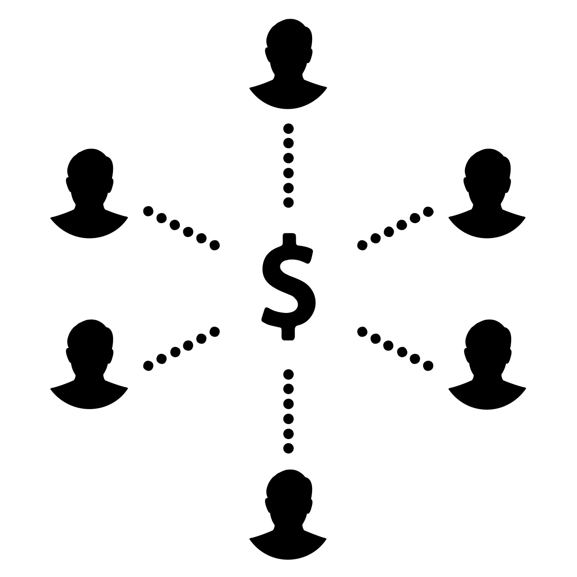
Crowdsourcing compensation
Compensation is used as a way to tempt participants to partake in a test. The value must be relevant to the amount of time it takes to complete a test
.
Notes:
Similar to compensations given to participants in a laboratory setting, compensation in a crowdsourcing environment is determined by the requester. In crowdsourcing, compensation is used as a way to tempt participants to partake in a test and the value must be relevant to the amount of time it takes the worker to complete a test.

Slide 7
Handling human subjects
In the United States, handling human subjects regulations include:
    Obtaining informed consent from participants
    Maintaining data confidentiality
    Participants’ right to opt out of the study at any time
In crowdsourcing, an experimenter must provide information that describes the study, the potential risks and benefits, and compensation. Consent can be obtained actively by requiring the participant to agree to the terms and conditions of the study and to click a button to navigate to the next page of the test
Notes:
Experimenters must obtain research approval and must abide by country laws for handling human subjects online. In crowdsourcing, an experimenter must provide information that describes the study, the potential risks and benefits, and compensation. Consent can be obtained actively by requiring the worker to agree to the terms and conditions of the study and to click a button to navigate to the next page of the test.

Slide 8
Experimental Design
A within subject study design is recommended for IQAs, using large number of content images divided into smaller image sets that become their own tests
Study length is better determined by running a pilot study (20-30 participants)
Number of stimuli is determined by running a pilot study (50-70 images max)
Pilot testing ensures experimental design accuracy to produce reliable data
Lengthy tests that induce boredom, fatigue, and disinterest
Test stimuli must cover a wide range of content quality
Common Likert scales for IQA ratings are ACR and DCR
Notes:
Pilot testing: When designing and executing research, experimenters must perform pilot testing to ensure that the experimental design is answering the questions posed by the researcher. As such, experimenters must pilot their study with 20-30 workers first to test data accuracy and reliability. If the accuracy of data decreases with time, experimenters must lesson the number of images rated per image set, shortening the length of the test.

Slide 9




Study Stimuli
Small image sets
Overlapping images
Validity checks images
Smaller image sets reduce time duration.
Validity checks maximize reliability and quality of data captured
Notes:
Experimenters are encouraged to include a large number of images to test with in order to minimize effects of any confounding variables. This large collection of images must then be divided into smaller image sets in order to reduce fatigue and boredom. Each smaller image set is treated as its own study, reducing the duration of the test and maximizing reliability and quality of data captured. The stimuli must be selected in accordance with to the goal of the test and the hypothesis established by the experimenters. The deciding factor to the number of images displayed per test should be decided upon based on pilot testing and pilot data analysis to determine data accuracy. Also, the short study design lessens the opportunities for technical failures, such as internet connectivity. It is recommended that the number of images per test not exceed anywhere between 50-70 images in an IQA study, including validity checks and the overlapping image set. However, a pilot is needed to ensure the accurate number of images per test.

Slide 10
Validity Checks
Validity checks are incorporated randomly into each image set
Types of validity checks:
  Open ended questions where a user is meant to answer by typing instead of selecting an answer from multiple choices
  Multiple choice questions where a user is instructed to select a specific answer
Failure to pass one or more checks requires the experimenter to remove participant from the analysis as the data collected is identified as invalid
Participants must be compensated for their time even if they failed the validity checks
Notes:
One way to screen for participants who are not paying attention is to remove them if they have failed attention checks. The merit to this approach is that you may reduce the amount of noise in your data.

Slide 11
Overlapping images
A common set of 10 images placed before every set of images in a series of studies that use the same image set
Images are used to assist experimenters with testing between subject stability and replicability of within subject ratings over time
Images are chosen from the original pool of images, ranging in quality from low to high quality
Representative of the contents of the photos in the original image set
Overlapping images serve as a training set placed in a random order in the beginning of each image set. Ratings collected for these images should be discarded from the analysis
The same images should be incorporated randomly in each image set as a test image as well

Slide 12

Study design
A within subject study design is encouraged for IQAs with large
number of content images, divided into smaller image sets that become their own tests
Participants can participate in as many tests as they desire
Test images must be shown in full screen mode to ensure clarity of image shown, especially if the test aims to discover perception of subtle changes in an image
Experimenters must use clear, specific, and unambiguous instructions, leaving no chance for misinterpretation
Email communication between participants and experimenters is encouraged to discover any encountered problems.
Notes:
participants must be allowed to participate in as many tests as they desire because experimenters must aim to approximate as much of a fully-crossed study as possible
test images must be shown in full screen mode to ensure clarity of image shown especially if the test aims to discover perception of subtle changes in an image

Slide 13
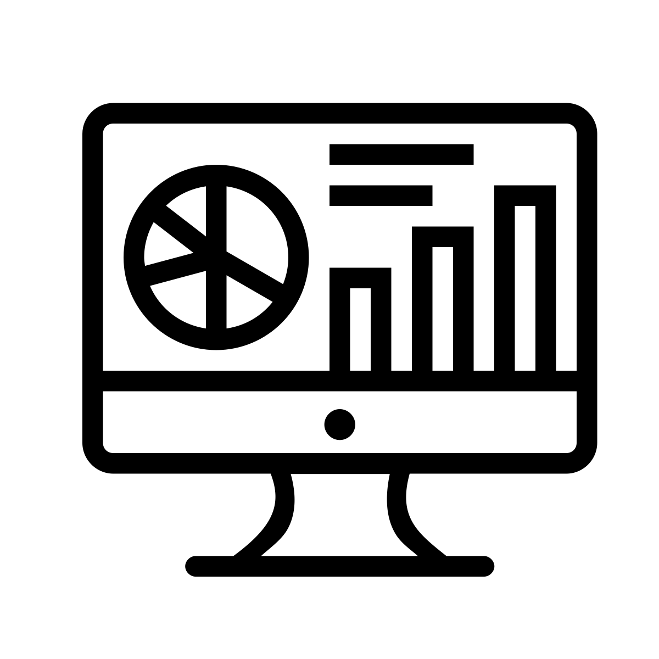
Data Analysis
Decide how to remove careless responders before analyzing
a completed crowdsourced dataset
Evaluate the types of devices that participants used in the study
Report the total number of unique participants
Consider evaluating the training images set to see if participants are responding similar to all of them
Correlate the data with lab “ground truth” data and visualize the bivariate relationship
Notes:
Before analyzing a completed crowdsourced dataset, decide how to remove “careless responders”. Does one careless response or multiple careless responses make the participant eligible for removal from the data set?
Evaluate the types of devices that participants used in the study. Is the screen size and device type adequate for comparisons?
If the same participants evaluated multiple image sets, it adds to the strength of the study so report the total number of unique participants
consider evaluating the “warm up” images to see if participants are responding similar to all of them
When first establishing a crowdsource study’s software and methodology, correlate the data with lab “ground truth” data and visualize the bivariate relationship. Ideally, there will be a rectilinear relationship between the controlled lab data and the crowdsourced data. If the relationship is not rectilinear, it may mean that the correlation between lab and crowdsourced data changes across either axis.

